Slide 1
CSE 6040/x Course Introduction Session
First Tuesday of the Course
Draft version: 1/13 (will provide final update after session)

Slide 2
Agenda
Course Introduction – Professor Richard Vuduc
Navigating the course web site, Piazza, and some important Canvas/edX module pages.
Common Student Questions on Exams and Homework Notebooks.
Introduction of Data Analysis in Python Bootcamp Series.

Slide 3
Course Materials
Course Website (cse6040.gatech.edu/active/)
Home Page, Announcements, Weekly Content
Logistics Pages
Exam Information Pages (when released)
Exam Prep Pages (when released)
Bootcamp Overview (schedule linked)
Guides (Honorlock, testcase, troubleshooting technical issues during exam)

Slide 4
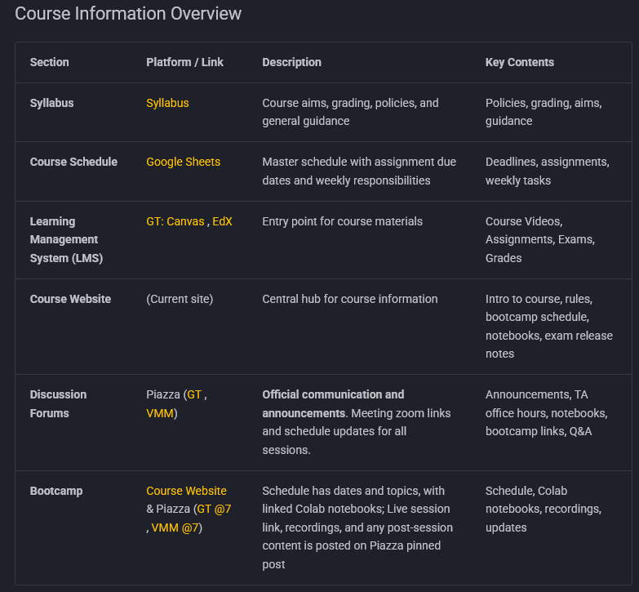
Locations
https://cse6040.gatech.edu/active/Logistics/1_intro_and_platforms/

Slide 5
Course Materials
Piazza – Discussion Forum
Only official means of course communication
For OSI-related academic violations, you will receive an email from Professor Vuduc or Chris directly*
Pinned Posts (Ongoing + Important)
Notebook Review Sessions – Thursdays, post @6.
Bootcamp – post @7.
TA Office Hours – post @8.
Homework Notebook Posts – All questions
Public and Private posts
We encourage students to make public posts, to encourage student discussion and collaboration.
Actual notebook code, as part of questions for TAs, must be posted privately.
Order: Pinned post -> public post -> private post
TAs can and probably will still reply to public posts(or thumbs up a good answer)
Private posts must be to all instructors

Slide 6
Course Materials
Canvas/edX – Learning Management System (“LMS”)
Main entry point for all assignments
Must access each assignment from here first
Where most course videos and related content are
Syllabus and Schedule (link to course website)
Common Student Questions Video
Introduction to Vocareum Video
Test Case Variables Pages -- Quiz and Videos
It is not possible to emphasize enough:
HOW IMPORTANT IT IS FOR ALL STUDENTS TO UNDERSTAND THE CONTENT IN THESE PAGES AND VIDEOS.
YOUR SUCCESS ON EXAMS IS DIRECTLY RELATED TO YOUR ABILITY TO TROUBLESHOOT YOUR CODE, USING THE TECHNIQUES PROVIDED IN THESE VIDEOS.

Slide 7
Common Student Questions
Exam Information (aka "Exam Rules & Policies")
Exams are open note and open internet.
Notes in any format are acceptable (digital, paper, etc.)
AI tools and active collaboration during the exam are not permitted. See the course web site for specifics, including AI search policy.
The exam window is open for 5 days, generally Friday morning to Wednesday morning, Eastern Time. See the course schedule for specific dates and times.
Times are listed in UTC, so ensure that you convert correctly from UTC to your local time zone.

Slide 8
Common Student Questions
Exam Information
The exams are generally 3.5-4 hours long.
Students open the exam and have the time length to complete the exam, in a single sitting.
Students can take the exam at any time during the exam window.
One thing to note on the exam window:
The exam window closes for everyone at the specified time, whether or not you have completed the exam.
While the exam length may be 4 hours, if you start the exam only 3 hours before the window closes, you will only have 3 hours to complete the exam.
If you are taking your exam when the exam window closes, Vocareum will not shut down for you, but you will no longer be able to SUBMIT your exam for grading.

Slide 9
Common Student Questions
Exam Information
Exams and Homework notebooks have UNLIMITED SUBMISSIONS.
In other words, you can submit as often as you want.
We ENCOURAGE students to submit AFTER EVERY EXAM EXERCISE, because it locks in points earned.
SUBMIT “early and often.”
Please don’t be that student who only submits once, at the very end of the exam, because you may not receive the points that you expect.
Homework Notebook Information
Homework notebooks also have UNLIMITED SUBMISSIONS, up to the (extended) due date.
See the course syllabus for specifics.

Slide 10
Exam Rule Callouts
Side-angle camera is required
Guide and rules posted on website: Guides/honorlock_side_angle_setup/
This requires you to use an iphone or Android phone, but we’d recommend using an external webcam if possible.
Your camera must show your entire work area
Copy/Paste is prohibited
All forms of it, no “work arounds” are permitted
Review AI search policy
Be familiar with it, you will still want to use Google during exams.

Slide 11
Bootcamp Introduction

Slide 12
Bootcamp Purpose
All Bootcamp sessions and materials are OPTIONAL, at each student’s discretion.
There is no requirement to attend any sessions or watch any of the posted videos.
Intended for students who may not have a rigorous programming background.
NOT to help with specific homework notebook problems.
Piazza and the Notebook Office Hours sessions (on Thursdays) are for that.
Bottom line, the Bootcamp is designed to help students be successful on the course exams.

Slide 13
Bootcamp Intro Topics
Bootcamp format – videos and live sessions.
Live sessions are “long form lectures”.
Similar to in person lecture classes.
4 Bootcamp Instructors – Rotating teaching.
Bootcamp Topics Address:
Content that is not part of the formal class materials (in Canvas/edX).
Identified skill gaps for many students during the test taking experience.
Topics that are (historically) covered on the exams (When you look at prior semester exams, you will see these topics).
But we are NOT TEACHING THE UPCOMING TESTS!!!

Slide 14
Bootcamp Conduct
Bootcamp schedules and session topics are on the bootcamp information page, linked from the course web site.
Any required announcements will be posted in the Bootcamp pinned Piazza post (both OMSA and VMM).
Zoom link for all Bootcamp sessions is posted in the O/MSA Piazza post, for the Bootcamp.
The live Bootcamp sessions are only available for the O/MSA students.

Slide 15
Bootcamp Conduct
All Bootcamp sessions will be recorded, with the videos posted on Piazza, for students who are not able to attend the live sessions. The recordings will be posted in both O/MSA and VMM Piazzas.
The video for each session will be posted within 24 hours of the session end.
For VMM, we must ensure that all personally-identifiable information (FERPA) has been removed or obscured, so posting there may take an extra day.

Slide 16
Should I Attend the Bootcamp?
Each student must decide for themselves whether attending the Bootcamp would be helpful for them.
We have provided a self assessment notebook, to help the students with this decision.
The notebook has both a version for students to write their own code in, and a solution version.
The links for the self assessment notebook versions are in the bootcamp information page, linked to on the course web site.
The self assessment notebook is OPTIONAL and is NOT GRADED.

Slide 17
Bootcamp Resources
Videos
Posted on Canvas/edX/Piazza
Current and prior semester Bootcamp content.
Bootcamp GitHub -- Public repositories
https://github.com/gt-cse-6040
Contains working and final versions of all Bootcamp materials.
Students are welcome to access the repository in read only mode.
Colab NBs
Part of GitHub site.
Class-developed content, not for grading.

